Slide 1
Webdevelopment - Basics

Slide 2
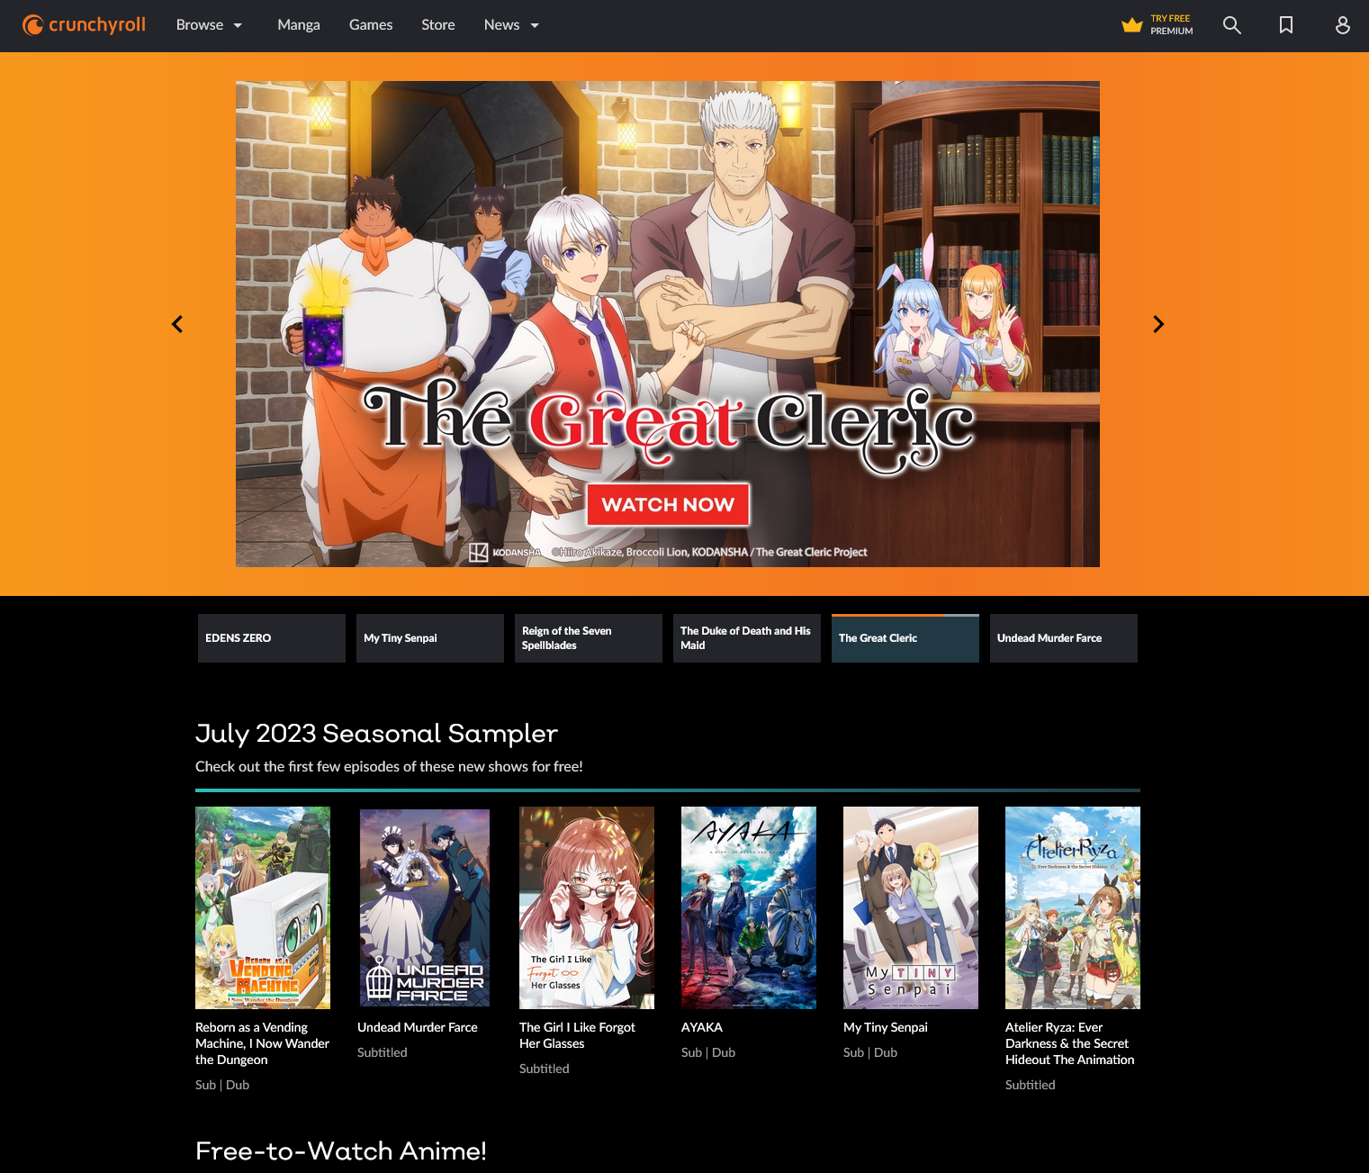
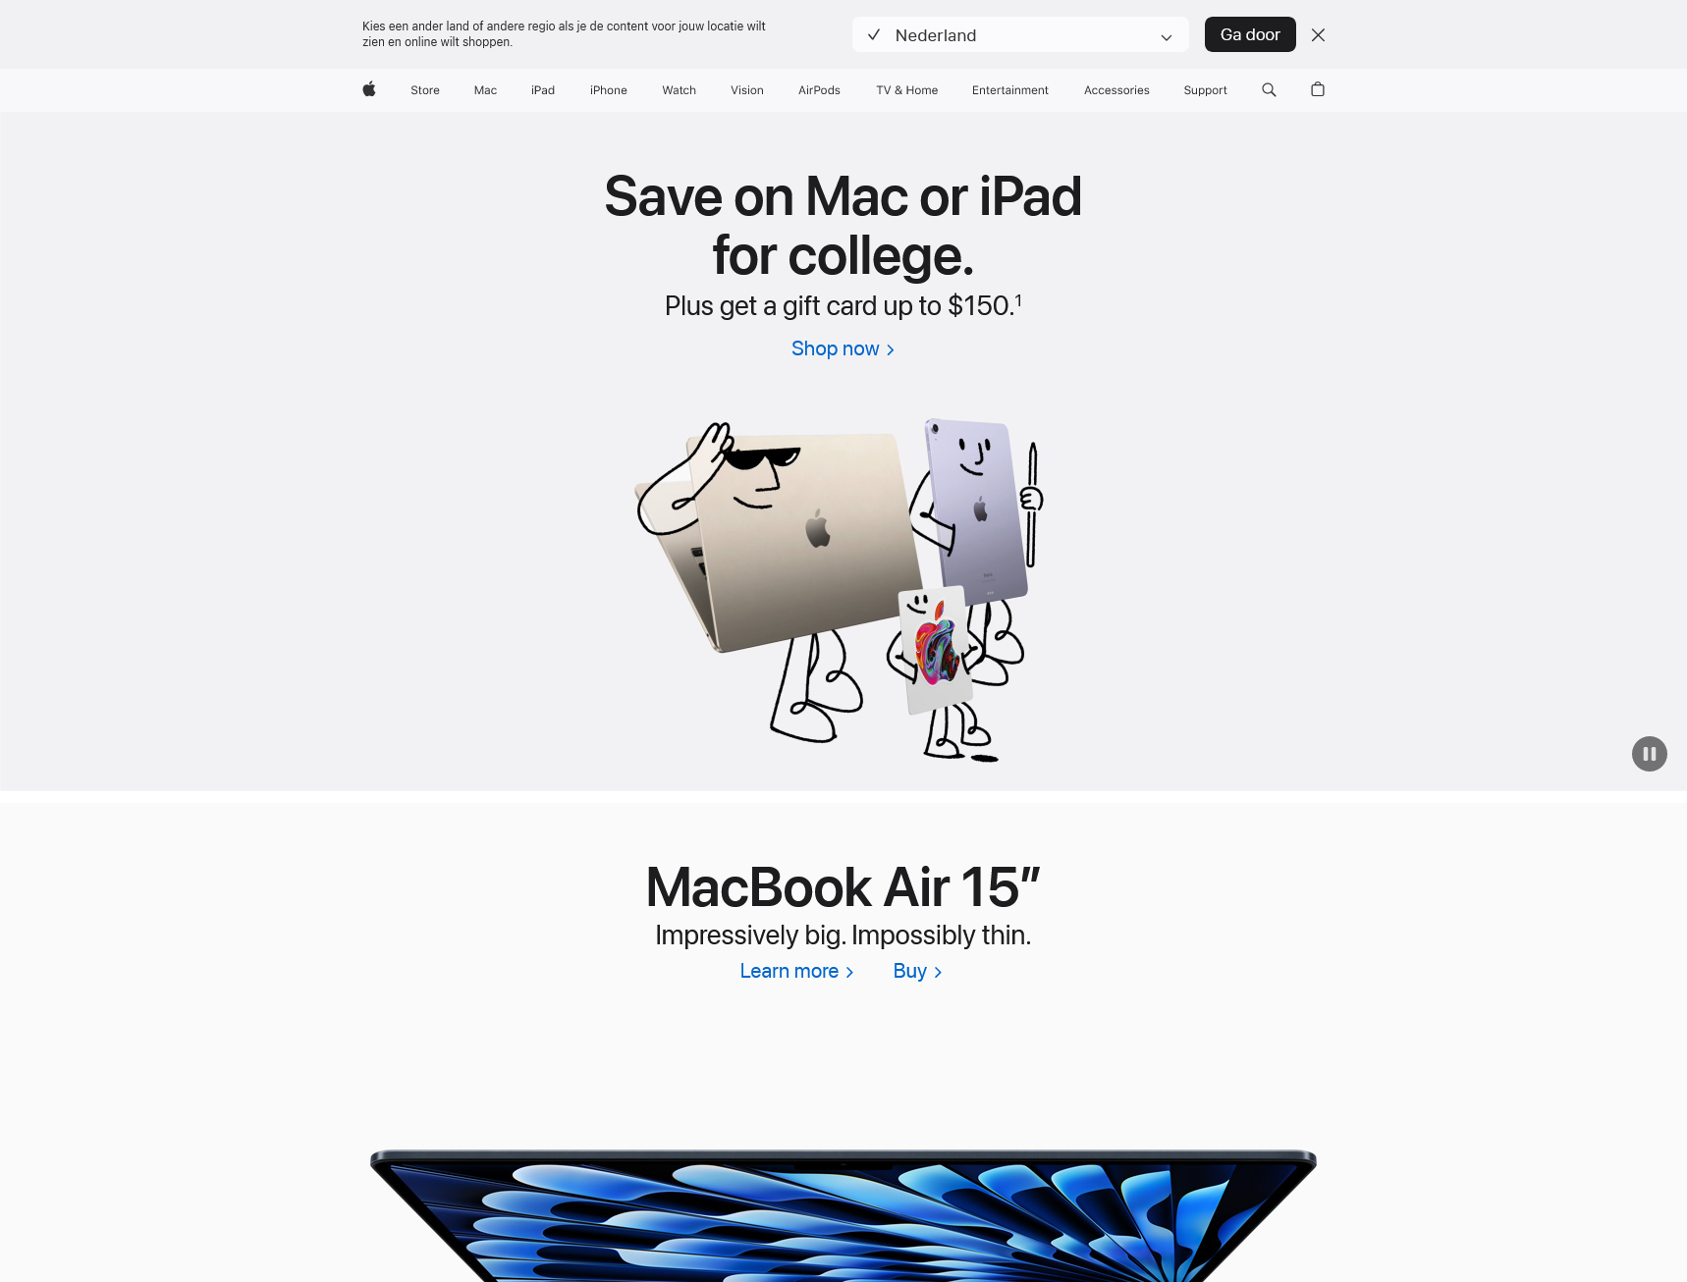
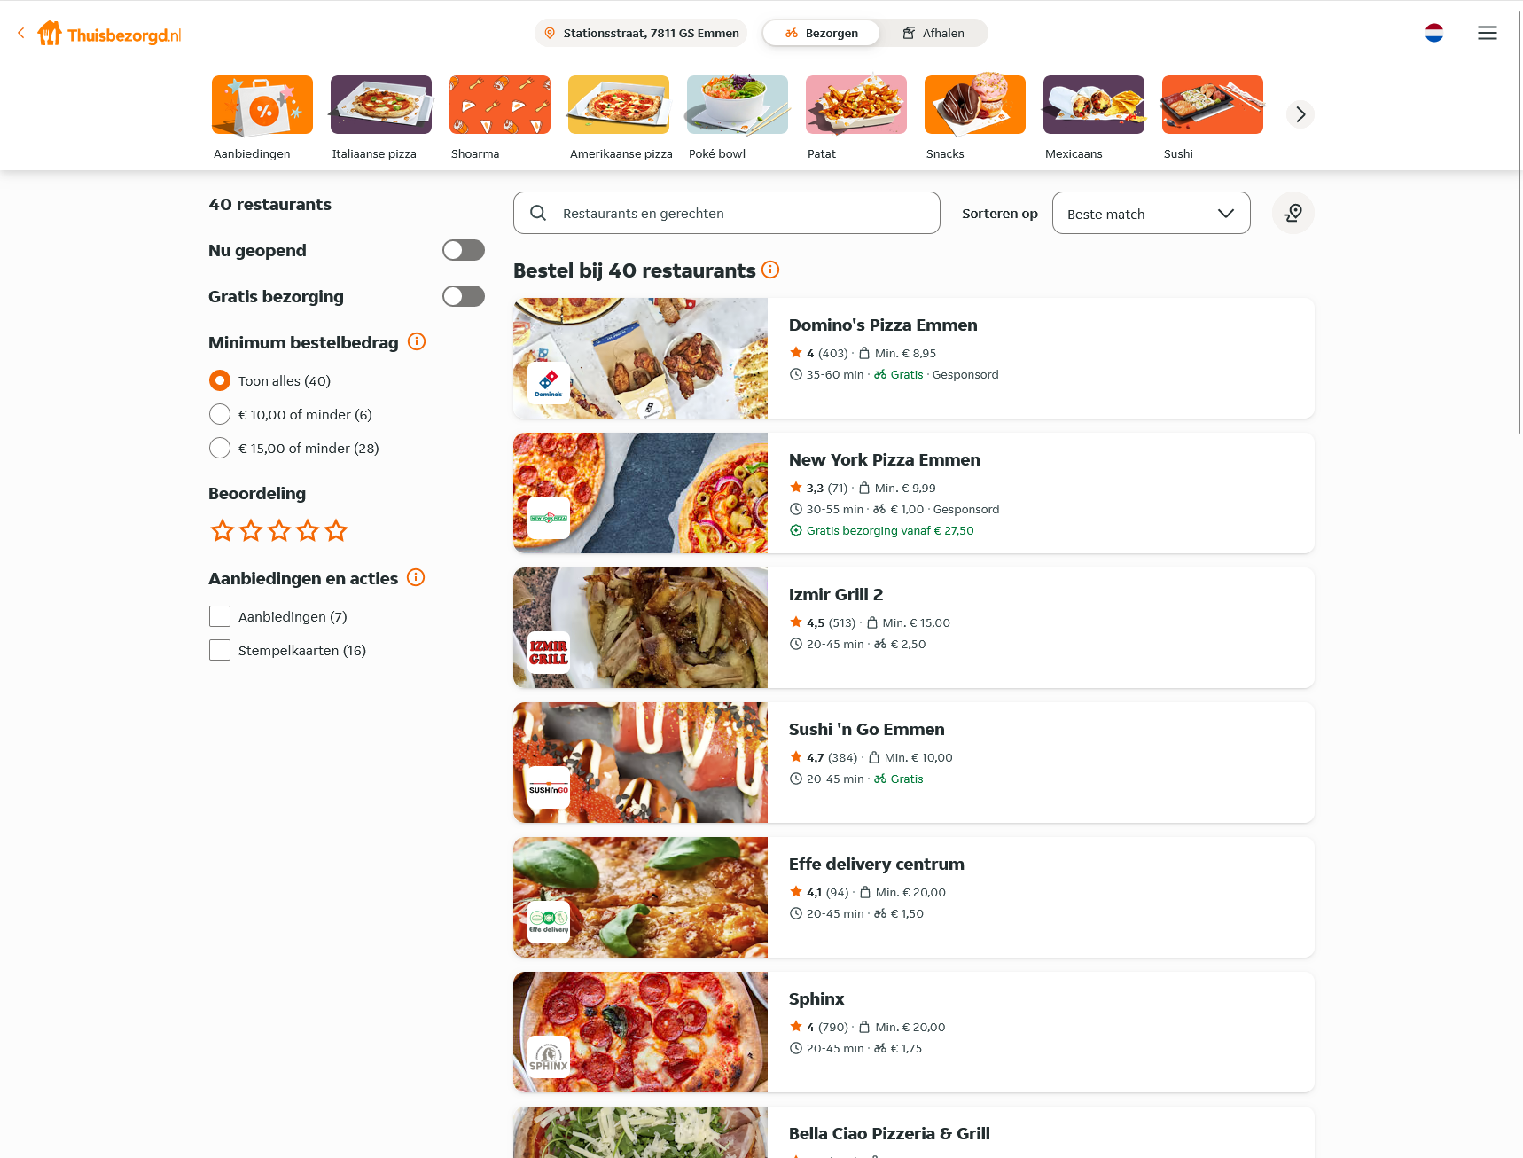

Webpage design and layout
Webpages can feature many different designs, such as…

Slide 3

Single column

Slide 4
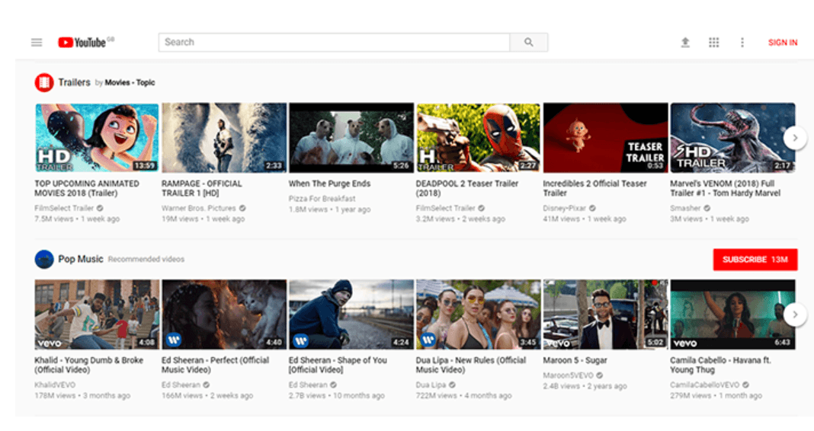
Card-grid

Slide 5
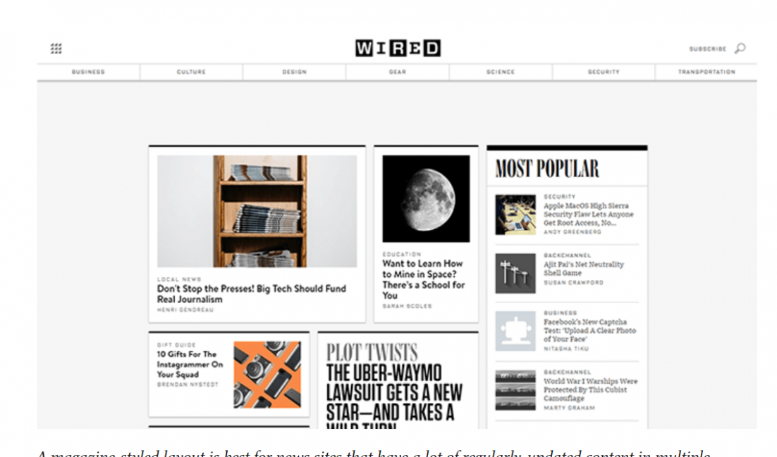
Magazine

Slide 6
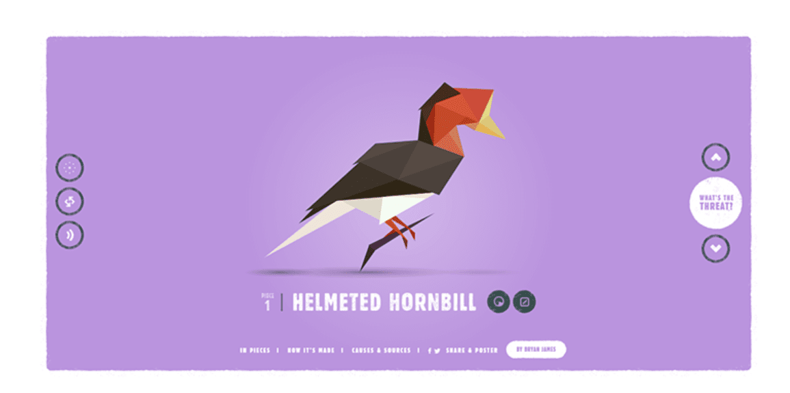
Featured Image

Slide 7
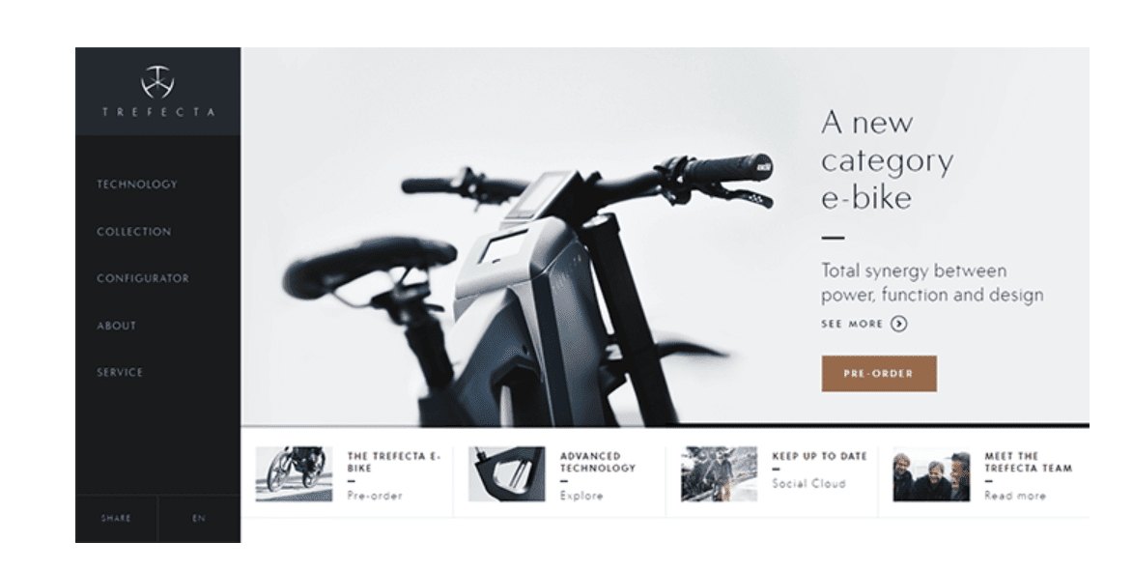
Fixed sidebar

Slide 8
Grids

Slide 9
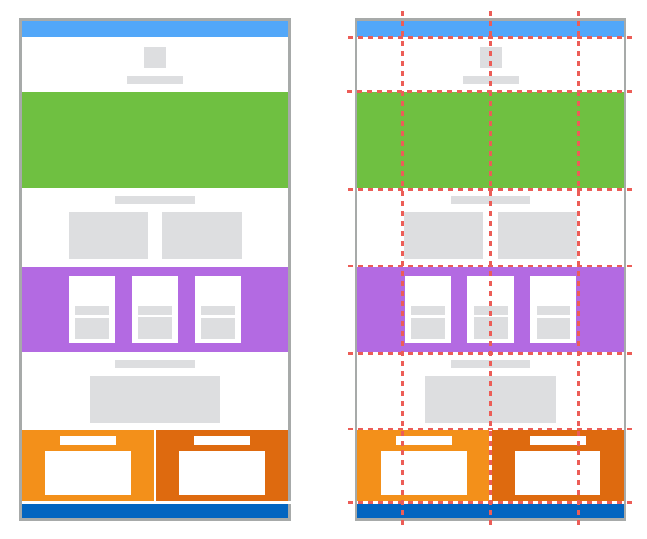
Grid
Method of ordening elements out on a responsive grid
Suited for 2 dimensional lay-outs
Provides ample control on the placement of items

Slide 10
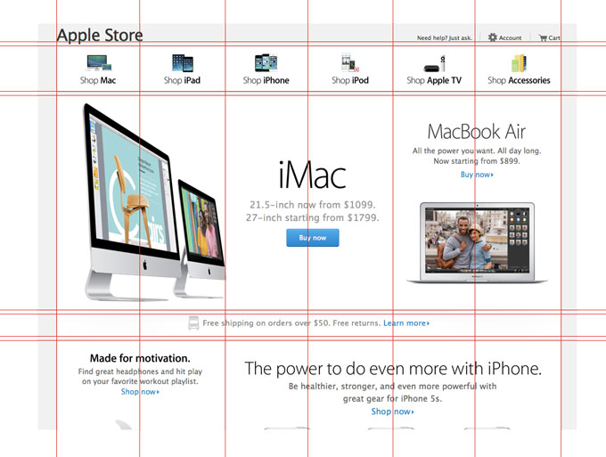
Grid lay-out
Establish a lay-out by dividing the webpage in columns (horizontal lay-out).
Per example: 8 columns
There is also the option of establishing rows (vertical lay-out), however it is wise not to do so.
Items can now be placed over 1 or multiple columns (and rows).

Slide 11
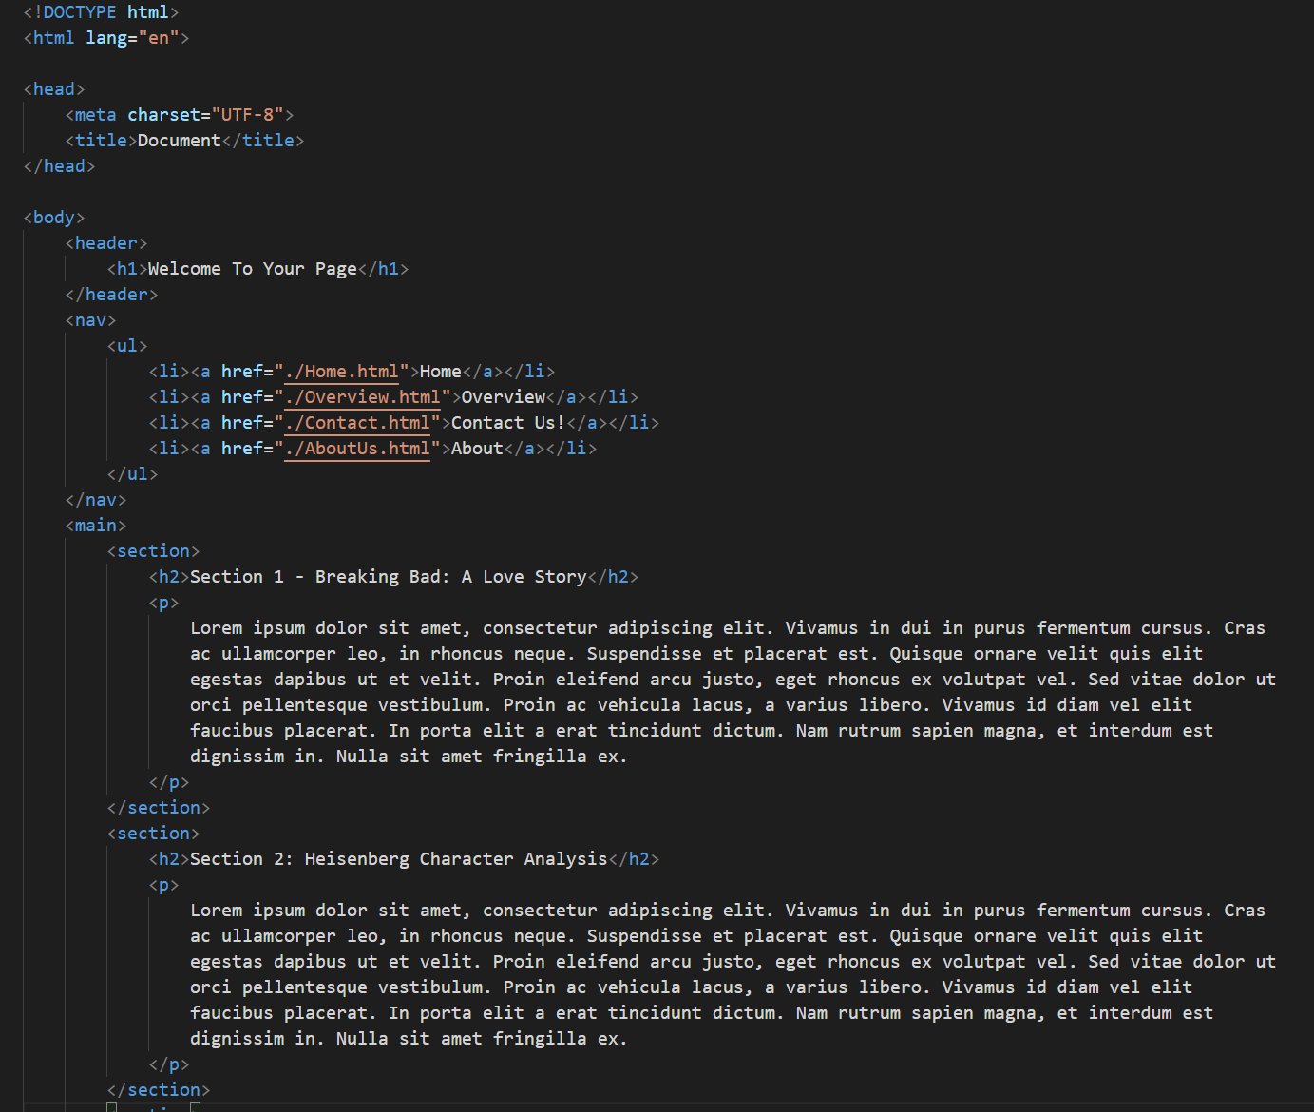
Demo 1
Grid Container
The HTML element that will receive the display: grid; attribute.
Grid Item
Direct HTML child of the grid container element.
Grid Line
Lines between columns and/or rows
Grid Track
A column or row
Grid Cell
A single cell in the grid
Grid Area
A combination of multiple grid cells

Slide 12
Demo recap
Display: grid;
Grid-template-columns, Grid-template-rows
Grid-column, Grid-row, Grid-area
Gap

Slide 13
Flexbox

Slide 14

Flexbox
Other method of ordening elements in your HTML
Small scale, responsive, 1-dimensional
Less control regarding placement, more flexibility and easy usage

Slide 15
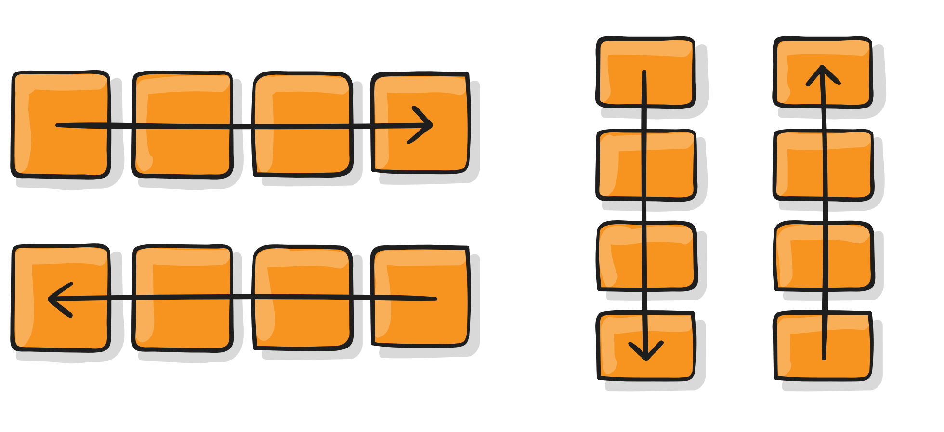
Flexbox direction
Flex-direction
Direction in which items will be placed
Row
Row-reverse
Column
Column-reverse

Slide 16
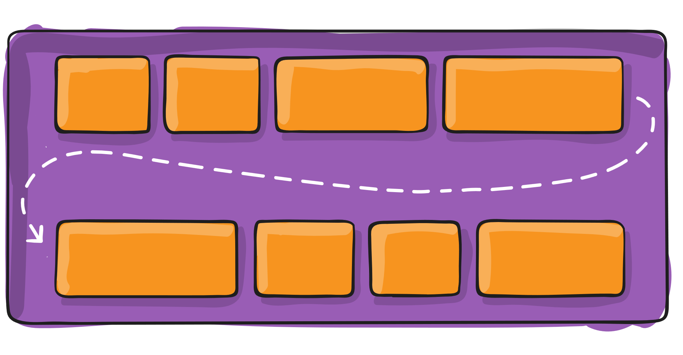
Flexbox wrap
Flex-wrap
Dictates the behaviour when overflow occurs
Nowrap
Wrap
Wrap-reverse

Slide 17
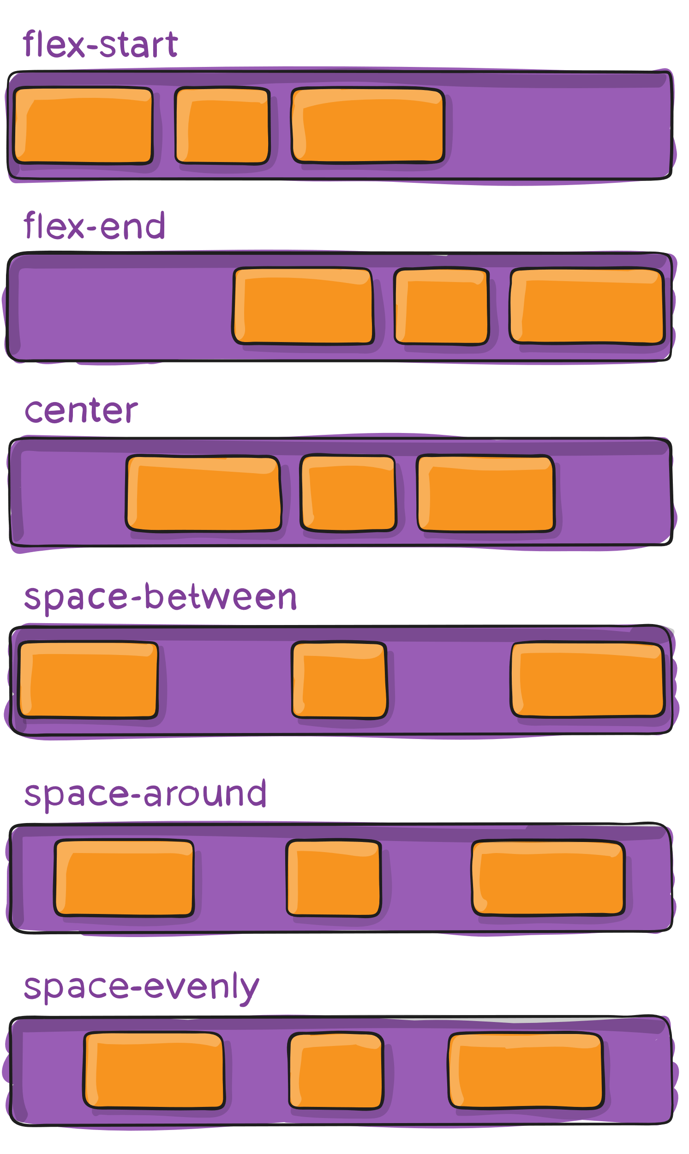
Justify content
Justify-content
Horizontal placement of the items in the flexbox
Dependent on flex-direction

Slide 18
Demo 1
Flex Container
The HTML element that will receive the display: flex; attribute.
Flex Item
Direct HTML child of the flex container element.
Flex-direction
Direction in which items will be placed.
Flex-wrap
Defines the flexbox behavior when overflow occurs.
Justify-content
Horizontal placement of flex items
Align-items
Vertical alignments of flex items

Slide 19
Demo recap
Display:flex;
Flex-direction;
Flex-wrap;
Justify-content;
Align-items;

Slide 20
PHP
Conditional statements

Slide 21
Conditional Statements
Core principal in programming
Dynamic aspect by offering a choice
Can be used for:
Validation – i.e. password checks and others.
Presentation – i.e. displaying certain information based on input.
Verification – i.e. is a connection established (for example Database connection).
And many other use cases.

Slide 22
Conditional Statements – If/Else

Slide 23
Demo 1

Slide 24
Conditional Statements – If/Else
If/Else statement
By default, offers 2 options due to the nature of If and Else
Can be extended upon by using elseif
Multiple conditions can be stacked within a single If
Needs comparison operators to completely function
Parallel If/Else statement
Two, or more, if/else statements side-by-side on the same ‘level’ of code
Allows for multiple outputs to be generated or multiple conditions to be verified without ‘overcomplicating’ the condition
Nested If/Else statements
Two, or more, if/else statements where the following statement only occurs as a result of a successful or failed previous if/else statement
Allows for complicated ‘roadmaps’ to be built as if building a unique route so all conditions can be assured a certain outcome.

Slide 25
Conditional Statements – Switch-case

Slide 26
Demo 1

Slide 27
Conditional Statements – Switch-case
Switch-case
Singular validation route conditional
Will only check if variable contains a certain value
Semantic
Multiple cases allow for easy ‘customized’ output or follow-up steps
‘Case collapsing’ allows for multiple cases to have the same outcome
Simplistic buildup compared to If/Else case

Slide 28
Questions?

